Slide 1
Personal Software ProcessSM for Engineers: Part II
Tutorial: Using PSP2

Slide 2
Tutorial Objectives
After this tutorial, you will
  understand the new PSP2 process elements
  know how to use the PSP2 scripts and forms
  be prepared to use PSP2 for program 5

Slide 3
PSP2 Objectives
The objectives of PSP2 are to introduce
  design and code reviews
  methods for evaluating and improving the quality of your reviews

Slide 4
New Process Elements
There are two new process elements.
  design review checklist
  code review checklist
Design and code review checklists are described separately.
PSP2 adds two key capabilities to the PSP
  design and code reviews
  quality planning
The PSP2 project plan summary supports these two new capabilities.

Slide 5
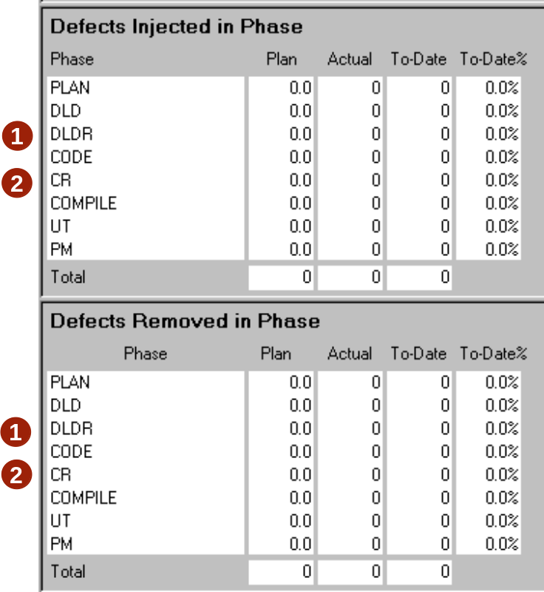
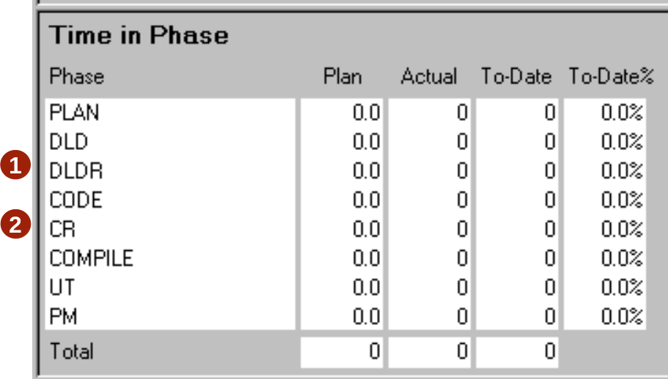
Design and Code Reviews
Two phases have been added to the process
  Design reviews (DLDR)
  Code reviews (CR)
Time and defect data from these phases are summarized on the PSP2 Project Plan Summary.

Slide 6
Quality Planning
PSP2 introduces quality planning.
Quality planning involves
  estimating the total number of defects that will be injected
  estimating the number of defects that will be injected and removed in each process phase
  estimating the amount of time needed for design and code reviews
  adjusting these parameters as needed to ensure a high quality result

Slide 7
Estimating Total Defects
To estimate the total defects injected and removed, use the estimated program size and to-date defect density to calculate the estimated total defects.
Use this formula
Planned total defects = | To-date total defects/KLOC ×
 | Planned Added and Modified LOC / 1000

Slide 8
Estimating Defects by Phase
To estimate defects injected and removed by phase, distribute the planned total defects injected and removed based on historical data.
  Planned Total Defects
  To Date % defects injected in each phase
  To Date % defects removed in each phase

Slide 9
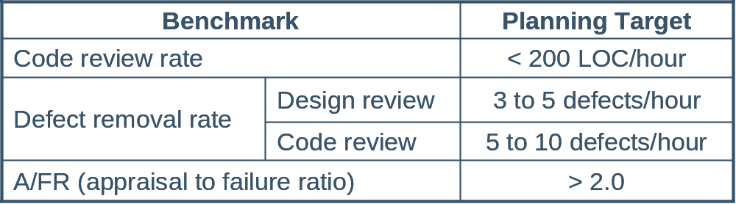
Estimating Review Time
These PSP benchmarks can be used to estimate design review and code review time in phase.
For manual calculations, starting with the code review rate is recommended.

Slide 10

Estimating With Review Rates -1
Benchmark data on code review rates can be used to estimate review time.
From PSP data, we know that code review rates under 200 LOC/hour generally give high yield.
Using planned added and modified LOC, code review time can be calculated using this formula.
Assume a similar rate for design reviews.

Slide 11
Estimating With Review Rates -2
To add review time to your plan
  increase the total minutes, and/or
  reduce compile and test time
As a final check of your estimate, make sure that
  review rates are less than 200 LOC per hour
  defect removal rates are between
    3 to 5 per hour for design review
    5 to 10 per hour for code review
  A/FR is about 2.0

Slide 12
Estimating Considerations
Initially no historical data are available for planning defects injected and removed in review phases.
Until you have data for design and code review phases, you may want to consider
  defects injected are 0
  defects removed should be based on your yield goal
Your yield goal should be based on your interim report analysis. If you do not have a yield goal, you should try to achieve greater than 60% yield.

Slide 13
Estimating Defects Removed
Defects removed in a review phase are calculated using
  number of defects escaping from prior phases
  number of defects injected in a phase
  percentage of defects removed, i.e. Phase Yield
Defects present | = | escapes + injected
Defects removed | = | present × phase yield

Slide 14
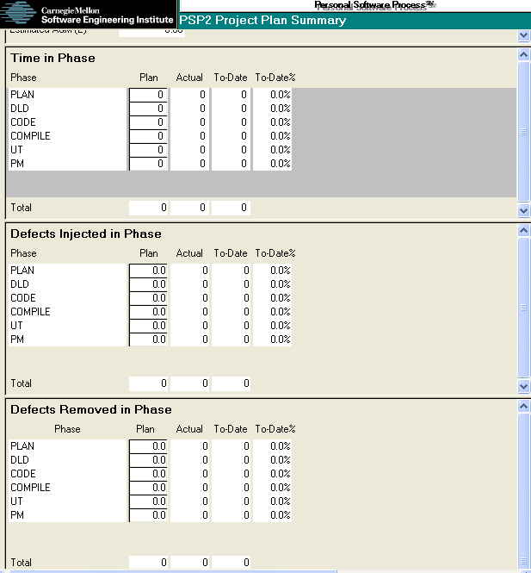
PSP2 Project Plan Summary
Complete your estimates of
  Time in phase
  Defects injected in phase
  Defects removed in phase
Enter these values on the PSP2 project plan summary.
1
2
3

Slide 15
Derived Quality Measures
PSP2 also provides the following derived quality measures.
  Defect removal efficiency
  Defect removal leverage
  Test defects per KLOC
  Total defects per KLOC
  Yield

Slide 16
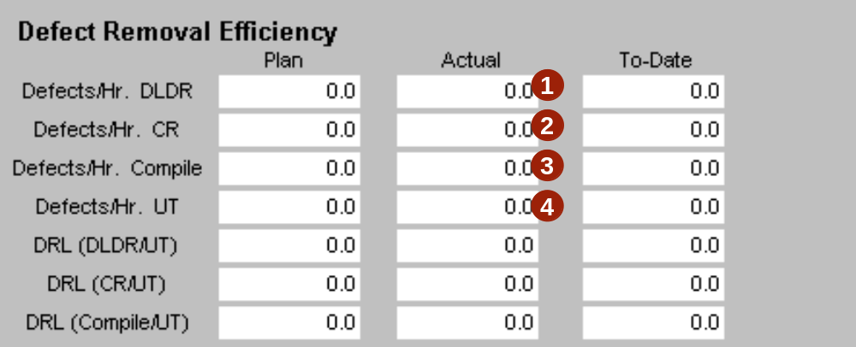
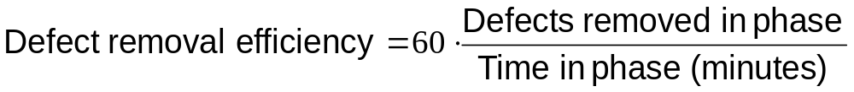
Defect Removal Efficiency
Defect removal efficiency is calculated automatically and
shows the number of defects removed per hour for
  Design review
  Code review
  Compile
  Test

Slide 17
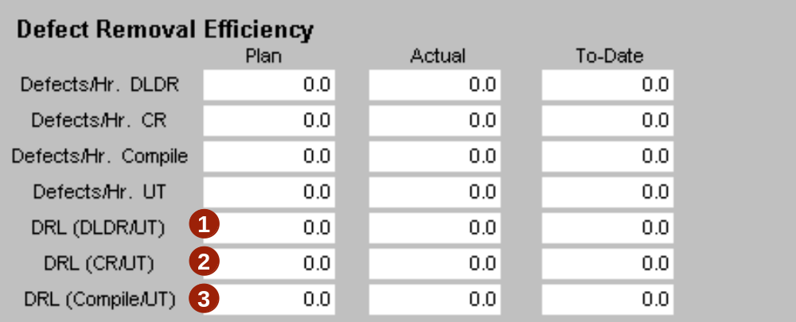
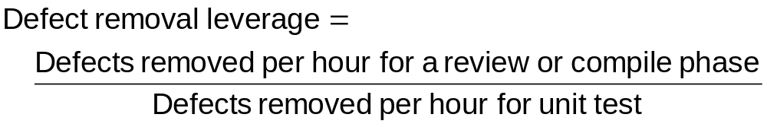
Defect Removal Leverage
Defect removal leverage is calculated automatically and
compares removal efficiency for
  Design Review vs. Unit Test
  Code Review vs. Unit Test
  Compile vs. Unit Test

Slide 18
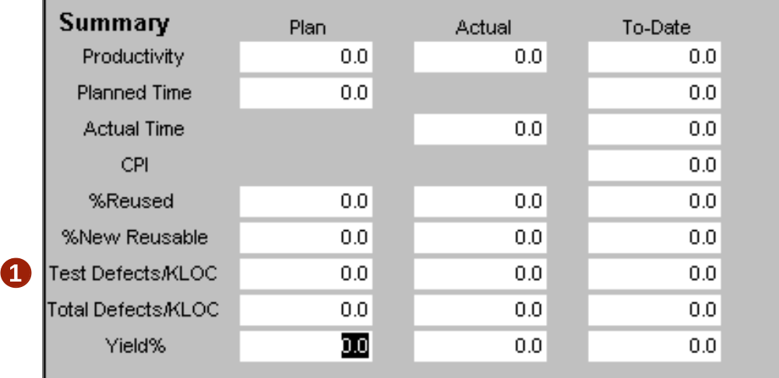
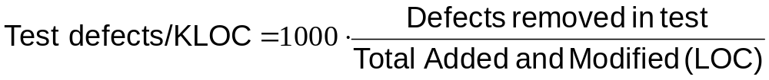
Test Defects Per KLOC
  Test defects per KLOC is calculated automatically and is an indicator of the quality of the program that you put into test.

Slide 19
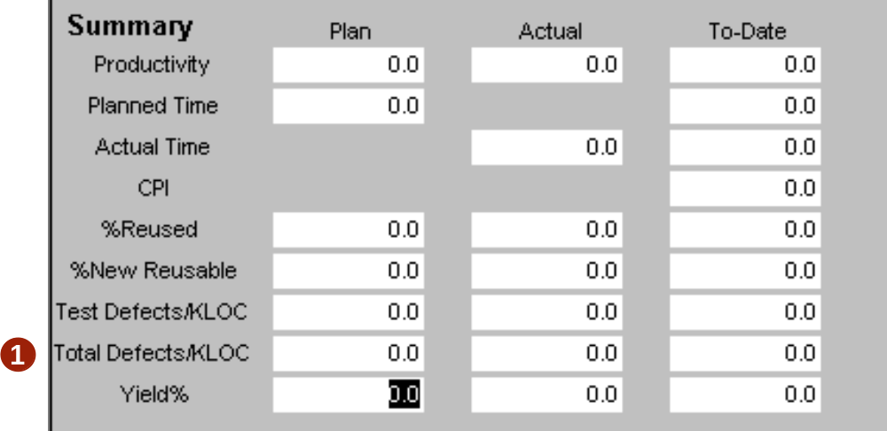
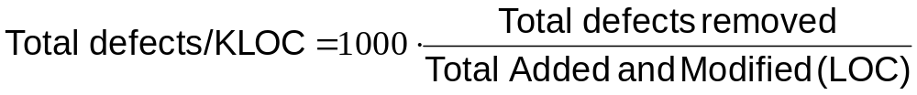
Total Defects Per KLOC
  Total defects per KLOC is calculated automatically and is a measure of the total defects injected during the process.

Slide 20
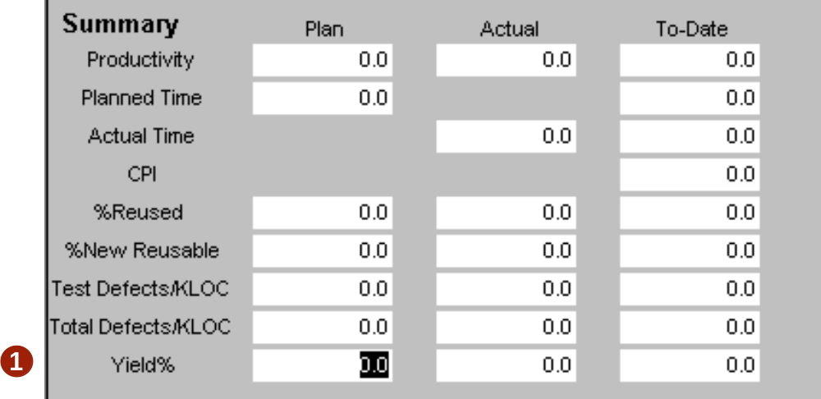
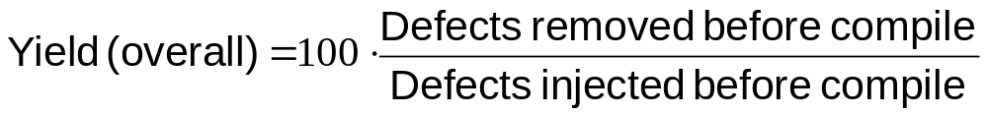
Yield
  Yield (actual and to-date) is calculated automatically for the entire process and is the percentage of defects injected and removed before the first compile.

Slide 21
Messages to Remember
You will see more improvement from design and code reviews than any other process change you make.
  Quality will improve.
  Productivity will increase.
PSP2 provides data that allows you to
  plan for specific quality levels
  control quality during development
  improve the quality of your PSP
  increase productivity without sacrificing quality

